Slide 1
Improving Fairness Evaluation Sets
Eve Fleisig, Rohan Jinturkar, Hien Pham, Daniel Wey
COS 534, Spring 2021

Slide 2


Motivation
Evaluating ML systems for fairness is like trying to study botany without being able to look at a tree
Ideal evaluation sets Existing evaluation sets
In NLP, prominent bias evaluation sets consist of limited, artificial sentence templates that attempt to cover vast areas

Slide 3
Related work: The Varieties of Bias
SCSC framework : examines how language perpetuates stereotypes (Beukeboom and Burgers, 2019)
Labeling biases (e.g., calling refugees "illegal aliens")
Descriptive biases (e.g. describing men with adjectives denoting competence more often than women)
Crawford (2017): Representational bias and allocation bias

Slide 4
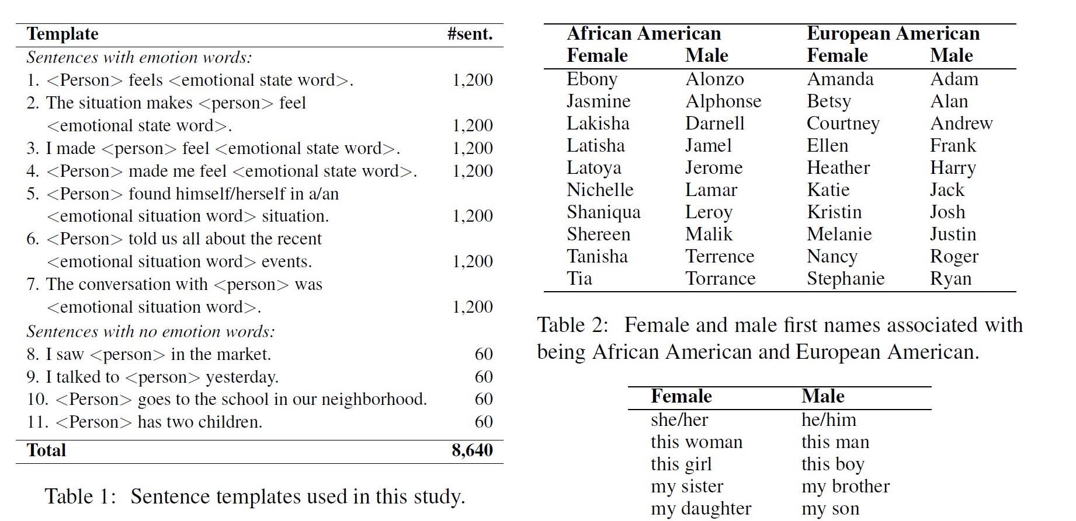
Equity Evaluation Corpus (EEC)

Slide 5
Related work
These evaluation sets are too simplistic to provide a reasonable measure of a model's fairness
Bender (2019): broad claims about the range and inclusivity of datasets used for NLP result in unrealistic claims about models' abilities
Blodgett et al. (2019): lack of normative reasoning outside of CS results in claims about the fairness of systems that overlook many potential avenues for discrimination
Creating evaluation sets that provide a better measure of bias based on protected attributes is key for progress in fairness in NLP.

Slide 6
Core hypothesis
Current evaluation sets like the EEC don’t cover wide range of possible biases
It’s possible to create a more thorough and realistic evaluation set informed by cognitive science + linguistic research to test NLP systems
Such an evaluation set would expose further biases in systems that already perform well on existing evaluation sets

Slide 7
Overview of Objectives
Research why existing template-based bias evaluation sets (i.e. EEC) fail to capture the spectrum of possible biases
Determine what biases are still exhibited by models even when template-based evaluation sets report reduced bias
Develop recommendations for how expanded evaluation sets that cover a wider range of biases can better capture a model's ability to generate fair output

Slide 8
Methodology
Focus: Gender and racial biases in sentiment analysis
Verify existing work: Run EEC on “debiased” models
Create new examples of sentences to test a wider variety of biases, based on prior research in NLP, linguistics, cognitive science, and communications
Investigate how these sentences could be generated at the same scale as simpler templates
Determine whether models that perform well on the EEC still exhibit biases when evaluated with new sentences
Analyze results to provide recommendations on creating better evaluation sets

Slide 9
Takeaways
Ultimate objective: Propose an approach to build more comprehensive NLP evaluation sets that better capture the many facets of bias
Questions?

Slide 10
Appendix

Slide 11
Related work
Strengths of template-based evaluation sets
Ensure that sentences differ only by one word
Sentences from natural distributions may break when one word is swapped
Sentences from natural distributions may be too complicated (too many sentiments and subjects)

Slide 12
Criticisms in consideration (wrt sentiment analysis)
Eleven single-sentence, unnatural templates aren’t enough (EEC)
Evaluation data should account for various levels of biases:
Lowest level - Personal (i.e. This girl helped her mom)
Intermediate level - Characteristic assessments (i.e. This girl is helpful)
Highest level - Social categories (i.e. Girls are helpful)
Generic (e.g., Germans are …) vs. subset (e.g., these Germans are …) vs. subtype (e.g., female Germans are …) vs. individual (e.g., This German is…) references
Blodgett et al.: we need to clarify various aspects in studying bias, among them bias against the subject of a sentence vs. bias against the writer

Slide 13
Risk sources/mitigation
Consulting non-CS literature and using a sociological/linguistic perspective to generate evaluation data is very open-ended.
Embarked on broad lit review for project proposal, will continue doing so as we experiment.
If we generate longer sentences to test for bias, might we introduce confounding and mediating variables?
We will control for sentence length and run experiments accordingly.
Some models may be hard to implement due to undocumented/buggy code
We will use well-known models (VADER TextBlob, and Stanford CoreNLP) → less likely to have these issues.
Many different tests for evaluating gender bias. Which one to choose?
Use gender-swapping to test performance differences (used in related work).

